Slide 1
Predict clinical effects using NGS data
PGS. TS. Nguyễn Quang Uy.
TS. Đỗ Văn Hoàn.
Trần Thanh Phương.
Trần Xuân Công.
Bảo Anh.
Bioinformatics Group - Le Quy Don Technical University

Slide 2
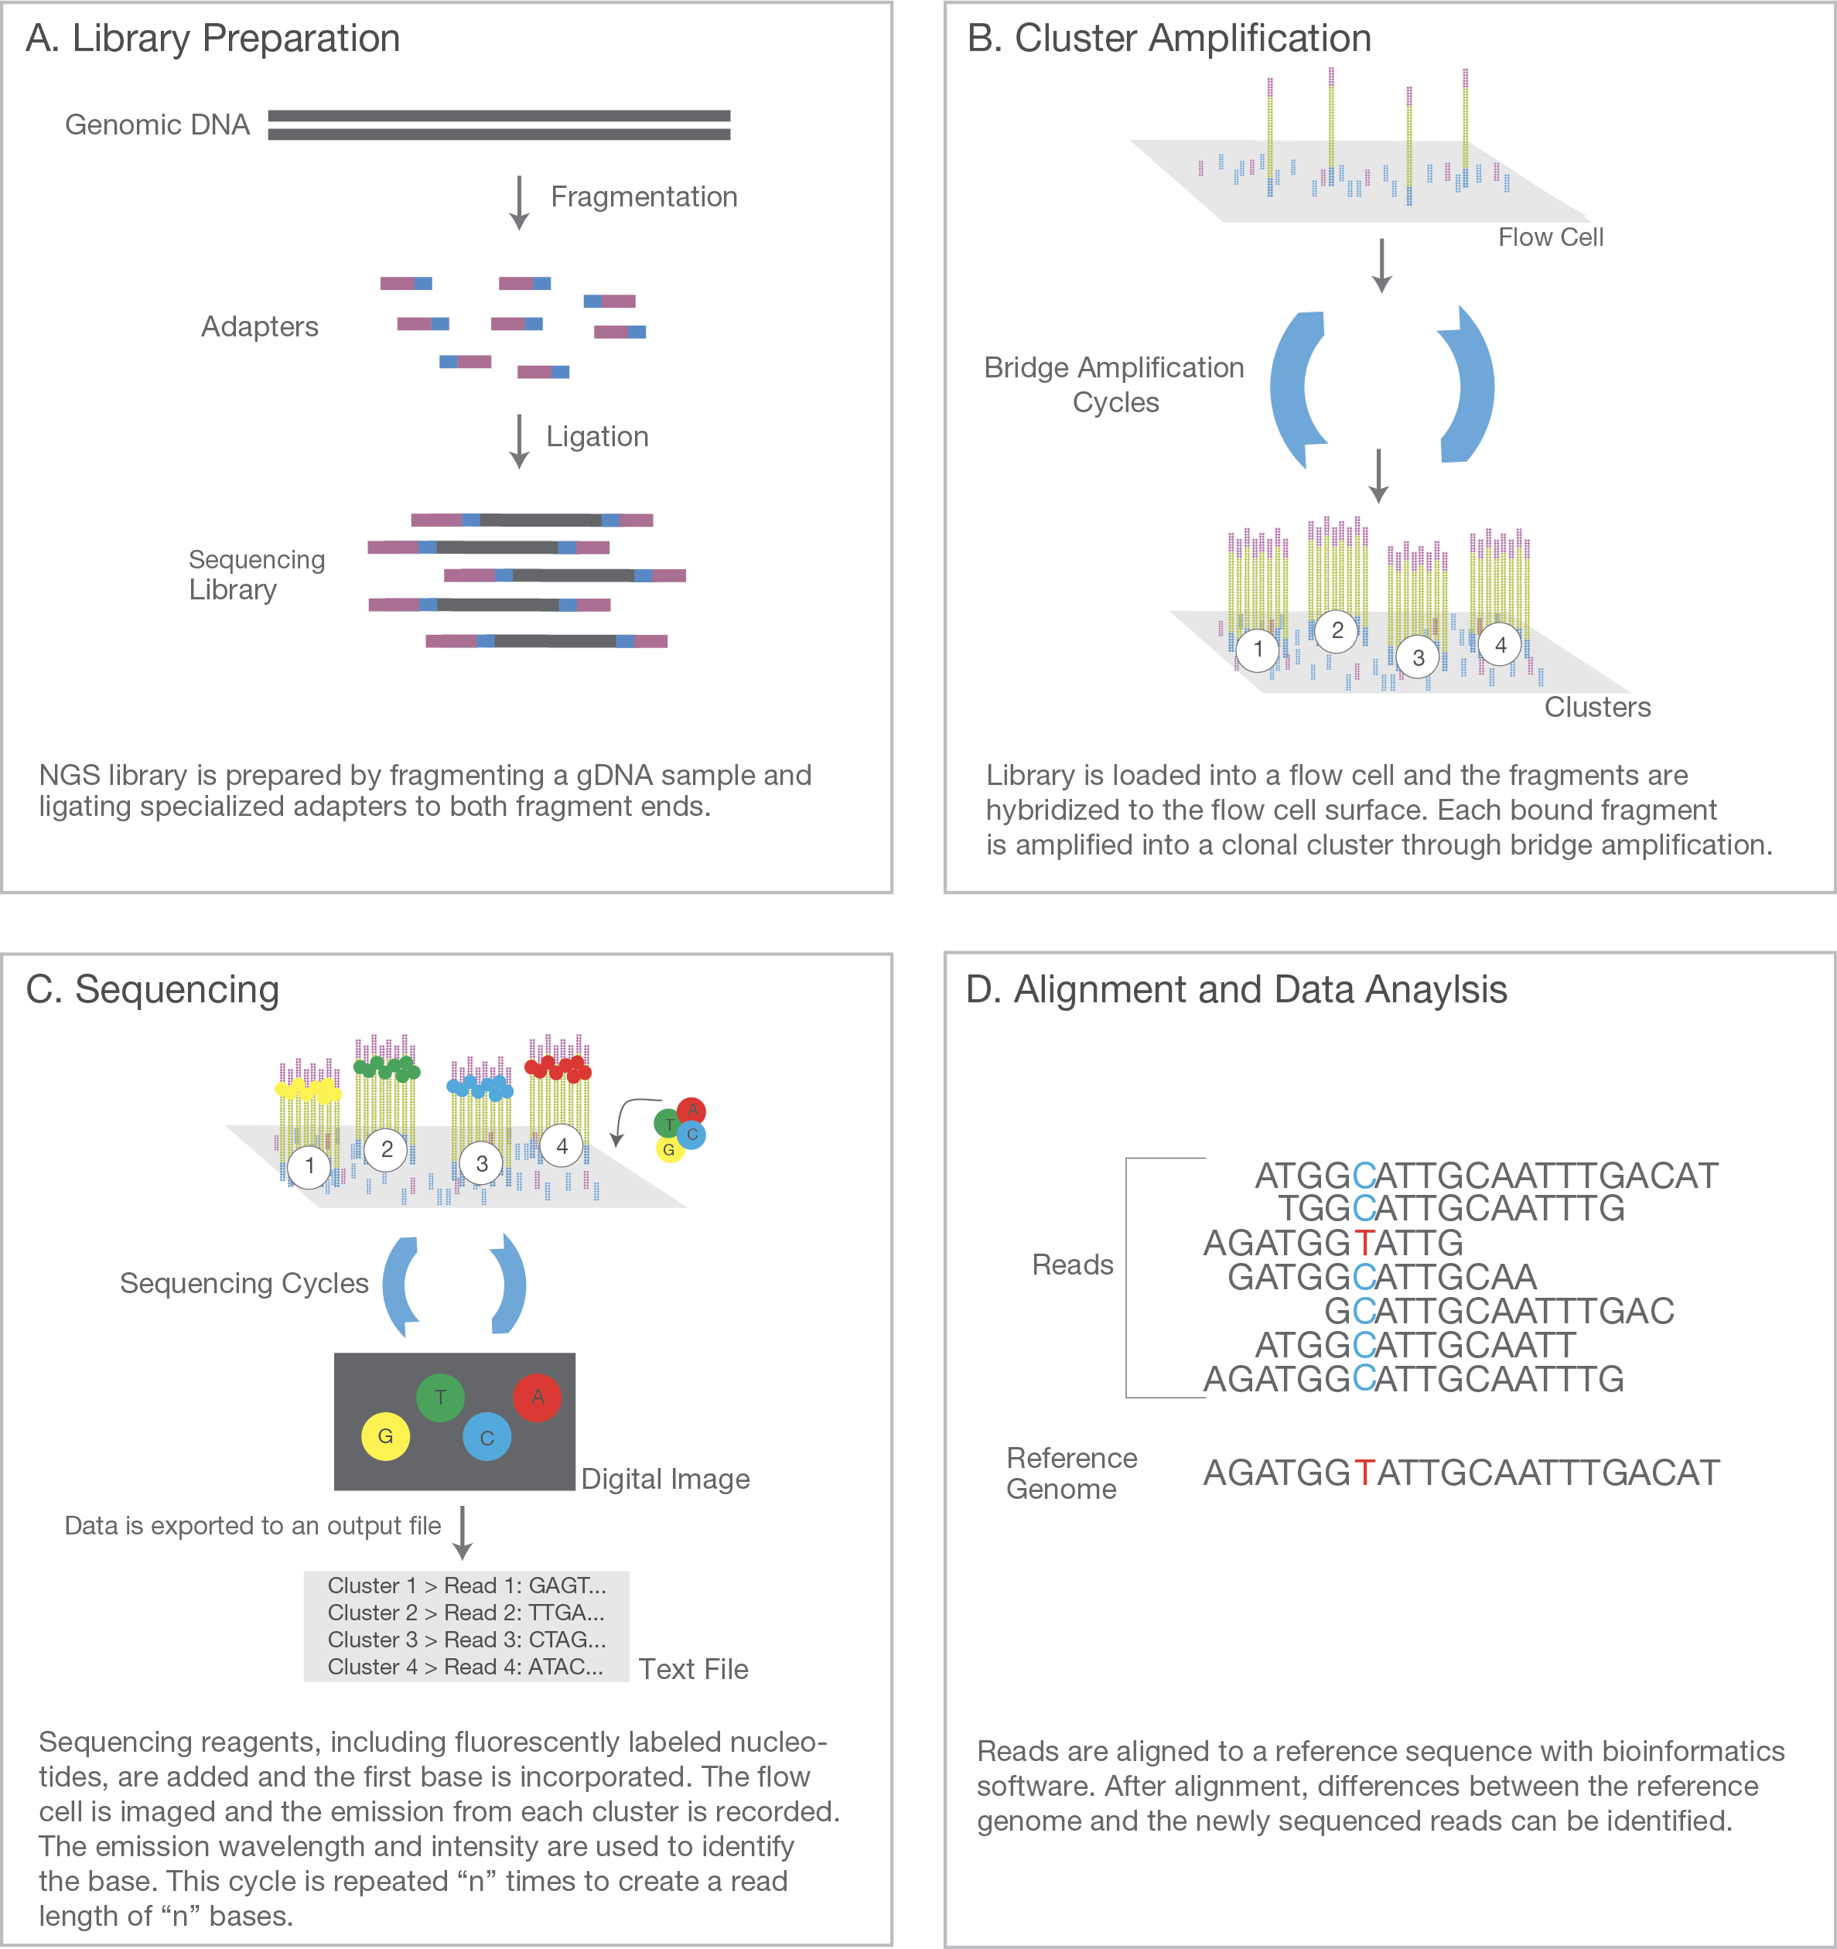
Illumina Sequencing
https://www.youtube.com/watch?v=fCd6B5HRaZ8

Slide 3
Basic variant calling in one sample
HG00097.bam
VariantCalling
HG00097_1.fastq
HG00097_2.fastq
Alignment
HG00097.vcf
FASTQ files
BAM files
VCF files

Slide 4
Alignment
HG00097.bam
HaplotypeCaller
HG00097_1.fastq
HG00097_2.fastq
BWA mem
HG00097.vcf
FASTQ files
BAM files
VCF files

Slide 5
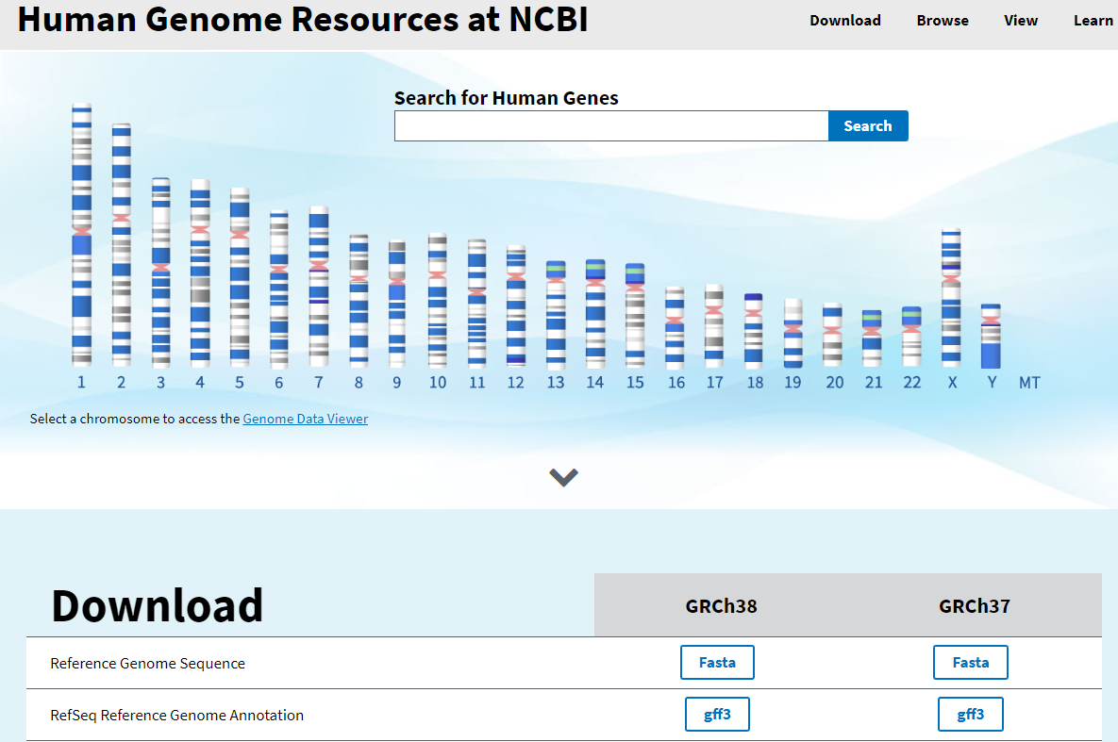
The reference genome
We used HG38 , the latest version of the human reference genome.

Slide 6
Keep track of the Reference version
The reference genome sequence is used as input in many bioinformatics applications for NGS data:
mapping
variant calling
annotation
Keep track of which version of the reference genome your data was mapped to.
The same version must be used in all downstream analyses.

Slide 7
Alignment
AACAGGTATATCTTCCCCGCTAGCTAGCTAGCTAGCTAGCTAGCTAGCTACCCTCTTCCTTAGGGACTGTAC
AACAGGTATATCTTCCCCGCTAGCTAGCTAGCTAGCTAGCTAGCTAGCTACCCTCTTCCTTAGGGACTGTAC
GCTAGCTAGCTAGCTACCCT

Slide 8
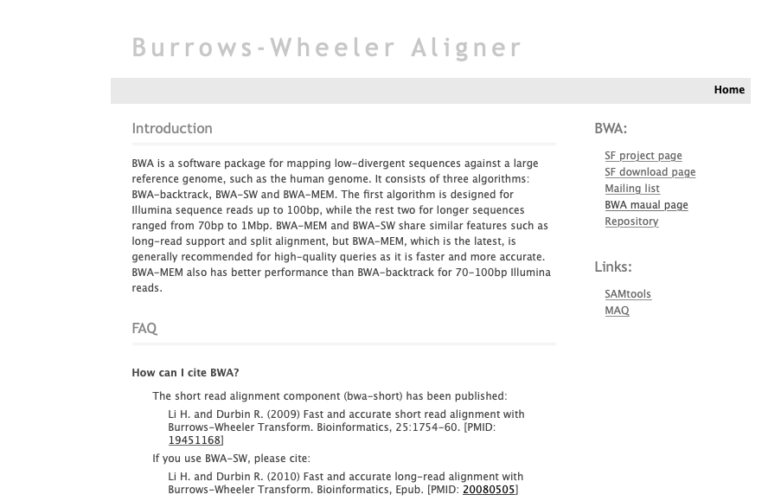
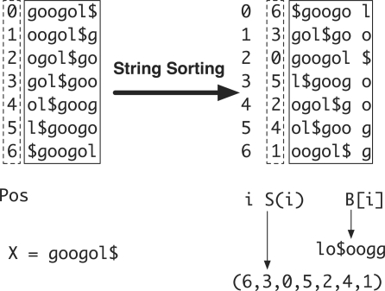
Burrows-Wheeler Aligner
http://bio-bwa.sourceforge.net
Burrows-Wheeler transform of reference genome

Slide 9
Output from mapping - Sam format
HEADER SECTION
@HD VN:1.6 SO:coordinate
@SQ SN:2 LN:243199373
@PG ID:bwa PN:bwa VN:0.7.17-r1188 CL:bwa mem -t 1 human_g1k_v37_chr2.fasta HG00097_1.fq HG00097_2.fq
@PG ID:samtools PN:samtools PP:bwa VN:1.10 CL:samtools sort
@PG ID:samtools.1 PN:samtools PP:samtools VN:1.10 CL:samtools view -H HG00097.bam
ALIGNMENT SECTION
Read_001 99 2 3843448 0 101M = 3843625 278 TTTGGTTCCATATGAACTTT 0F<BFB<FFFBFBFFFBFBB
Read_001 147 2 3843625 0 101M = 3843448 -278 TTATTTCATTGAGCAGTGGT FBBI7IIFIB<BBBB<BBFF
Read_002 163 2 4210055 0 101M = 4210377 423 TGGTACCAAAACAGAGATAT 0IIFBFFFIIIFFIFFFBBF
Read_003 99 2 4210066 0 101M = 4210317 352 CAGAGATATAGATCAATGGA 0IIFFFIFFFIFIFIIIIIF
Start position
Quality
Reference sequence name
Sequence
Read name
(usually more complicated)
Notes:
QNAME: the name of the read.
FLAG: a bitwise number describing information about the read such as mapped/unmapped read, pairing, etc.
RNAME: the reference sequence name. The value of this field is * for unmapped reads.
POS: the left most mapping position of the first matching base. It is set to zero for unmapped reads.
MAPQ: a number to indicate the mapping quality.
CIGAR: a string describing how the read aligns with the reference. It consists of one or more components. Each component comprises an operator and the number of bases which the operator applies to. Operators are: MIDNSHP=X. The following table gives an overview of these operators
MNAME: the name of the mate strand, if it is a paired read. ‘=’ means that the name is the same as RNAME.
MPOS: a number indicating the left most mapping position of the mate.
TLEN: a number set to 0 for single-segment. For paired-segments it is calculated as the number of bases from the left most mapped base to the right most mapped base.
SEQ: the read sequence as the reference. If not ‘*’ then the length of the sequence must be equal the sum of lengths of M/I/S/=/X operations in the CIGAR string.
QUAL: the read quality, same as the quality string in a fastaq format.

Slide 10
Convert to Bam
Bam file is a binary representation of the Sam file

Slide 11
Variant calling
HG00097.bam
HaplotypeCaller
HG00097_1.fastq
HG00097_2.fastq
BWA mem
HG00097.vcf
FASTQ files
BAM files
VCF files

Slide 12
Genetic variation
SNV
Genetic variation = differences in DNA among individuals of the same species

Slide 13
Detecting variants in reads
Reference: ...GTGCGTAGACTGCTAGATCGAAGA...
Sample: ...GTGCGTAGACTGATAGATCGAAGA...
...GTGCGTAGACTGATAGATCGAAGA...
...GTGCGTAGACTGCTAGATCGAAGA...
...GTGCGTAGACTGCTAGATCGAAGA...
...GTGCGTAGACTGATAGATCGAAGA...
...GTGCGTAGACTGATAGATCGAAGA...
...GTGCGTAGACTGCTAGATCGAAGA...
...GTGCGTAGACTGATAGATCGAAGA...
...GTGCGTAGACTGCTAGATCGAAGA...
...GTGCGTAGACTGATAGATCGAAGA...
Notes:
Variant calling is looking for positions where some number of reads disagree with the reference genome. Here for example the reference sample says the position should be a C whereas 6 of the reads say it is an A in the sample. This is also what is meant with the allelic frequency of a variant, out of 10 reads 6 are variant therefore the allelic frequency of A is 60%.
Note that this is not the same as population based allele frequencies that measures the relative frequency of an allele in a population.

Slide 14
Reference- and Alternatve Alleles
TGGGCTTTTCCAACAGGTATATCTTCCCCGCTAGCTAGCTAGCTACTTCAAATTCCT
Reference allele
AGCTAGCTA
Alternative allele
AGCTGGCTA
Reference allele = the allele in the refence genome
Alternative allele = the allele NOT in the refence genome

Slide 15
Variant Calling HaplotypeCaller
For more info: https://www.youtube.com/watch?v=NQHGkVGICpY
Notes:
Define active regions. Identify regions of the genomes in which the samples being analyzed show substantial evidence of variation relative to the reference.
Determine haplotypes by local assembly of the active region.The goal of this step is to reconstruct the possible sequences of the real physical segments of DNA present in the original sample..
The most likely haplotypes, supported by many reads, are reported. All haplotypes are then aligned against the reference genome, and variant sites are reported.
3. Determine likelihoods of the haplotypes given the read data. For each ActiveRegion, the program performs a pairwise alignment of each read against each haplotype using the PairHMM algorithm. The algorithm takes into account the information the quality of the data (i.e. the base quality scores and indel quality scores). This produces a matrix of likelihoods of haplotypes given the read data.
These likelihoods are then marginalized to obtain the likelihoods of alleles per read for each potentially variant site.
4. Assign sample genotypes. Calculates the posterior likelihoods of each genotype per sample given the read data observed for that sample. For each variant, the most likely genotype is then assigned to the sample.

Slide 16
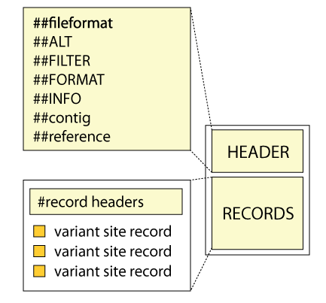
Variant Call Format (VCF)

Slide 17
Variant Call Format (VCF)
##fileformat=VCFv4.3
##fileDate=20090805
##source=myImputationProgramV3.1
##reference=file:///seq/references/1000GenomesPilot-NCBI36.fasta
##contig=<ID=20,length=62435964,assembly=B36,md5=f126cdf8a6e0c7f379d618ff66beb2da,species="Homo sapiens”... ##phasing=partial
##INFO=<ID=NS,Number=1,Type=Integer,Description="Number of Samples With Data">
##INFO=<ID=DP,Number=1,Type=Integer,Description="Total Depth">
##INFO=<ID=AF,Number=A,Type=Float,Description="Allele Frequency">
##INFO=<ID=AA,Number=1,Type=String,Description="Ancestral Allele">
##INFO=<ID=DB,Number=0,Type=Flag,Description="dbSNP membership, build 129">
##INFO=<ID=H2,Number=0,Type=Flag,Description="HapMap2 membership">
##FILTER=<ID=q10,Description="Quality below 10">
##FILTER=<ID=s50,Description="Less than 50% of samples have data">
##FORMAT=<ID=GT,Number=1,Type=String,Description="Genotype">
##FORMAT=<ID=GQ,Number=1,Type=Integer,Description="Genotype Quality">
##FORMAT=<ID=DP,Number=1,Type=Integer,Description="Read Depth">
#CHROM POS ID REF ALT QUAL FILTER INFO FORMAT NA00001 NA00002 NA00003
14370 rs6054257 G A 29 PASS NS=3;DP=14;AF=0.5;DB;H2 GT:GQ:DP 0|0:48:1 1|0:48:8 1|1:43:5
20 17330 . T A 3 q10 NS=3;DP=11;AF=0.017 GT:GQ:DP 0|0:49:3 0|1:3:5 0|0:41:3
20 1230237 . T . 47 PASS NS=3;DP=13;AA=T GT:GQ:DP 0|0:54:7 0|0:48:4 0|0:61:2
20 1234567 microsat1 GTC G,GTCT 50 PASS NS=3;DP=9;AA=G GT:GQ:DP 0|1:35:4 0|2:17:2 1|1:40:3
Notes:
VCF files, or variant call format files, are divided into two main parts. The top, or head, of the file, with hashtag prefixed lines, is a descriptive part explaining the information given for each variant and each sample, if multiple samples exists. It also gives the date and some information from the variant caller used.
Below this are the actual variants, one line per variant.
Now lets look at each part alittle closer.
(Update later to latest vcf format)

Slide 18

https://gatk.broadinstitute.org

Slide 19
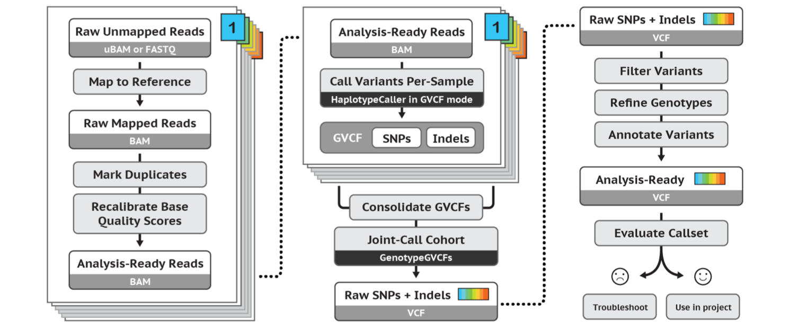
GATK’s best practices workflow for germline short variant discovery
https://software.broadinstitute.org/gatk/best-practices/

Slide 20
Mark Duplicates
Notes:
But before we dive in to alignment I will mention that this is where the recommendations of the Broad institute best practices start. A guide that they have maintained pretty-well for several years where they recommend tools and setting to use for a standard analysis. I recommend that someone setting up a bioinformatics workflow or wanting to compare what has been done with their data and what is currently considered best practice be intimately aware of these recommendations.
//A recent change has been made where they no longer recommend indel realignment, as it is performed on the fly at the variant calling stage. It is good to note that this resource exists, as it is definitely something you should be looking at when running a variant calling pipeline as it is needed in some cases.

Slide 21
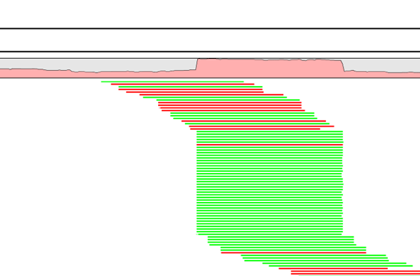
Duplicate reads
PCR duplicates - library preparation
Optical duplicates - sequencing
Don’t add unique information
Gives false allelic ratios of variants
Should be removed/marked
Notes:
One tool for this is picards MarkDuplicates.
Occur PCR
Copies same fragment goto different flowcells
High library complexity is good
Don’t add information
Optical duplicates
Less talked about
One flowcell cluster
Incorrectly identified on several cells
Amplicon
Duplicates typically arise during PCR amplification of the fragments with adapters. We are intentionally creating multiple copies of each original genomic DNA molecule so that you have enough of them. The PCR duplicates occur when two copies of the same original molecule get onto different areas of the flowcell. A greater amount of starting material, often termed as having a high complexity library, is a good indicator of not having a big problem with duplicates.
And duplicates don’t give any additional information, as you can see here, what we want is reads slightly off from eachother, so we know that they are adding new information. You can also choose to just mark the duplicates rather than remove them entirely as many variant callers can ignore reads marked as duplicates. This gives you the option later to perform variant calling with and without duplicates and compare the results.
Finally, during some kinds of sequencing, such as amplicon sequencing, you tend to recommend not removing duplicates as there will be many duplicates by design. So keep that in mind.
“optical duplicates are sequences from one flow cell cluster, that are (incorrectly) identified by software to be from multiple adjacent clusters. ”

Slide 22
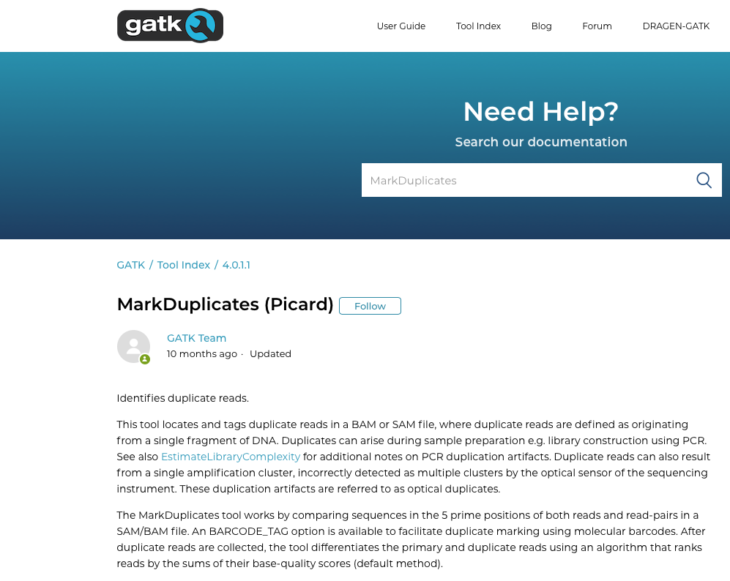
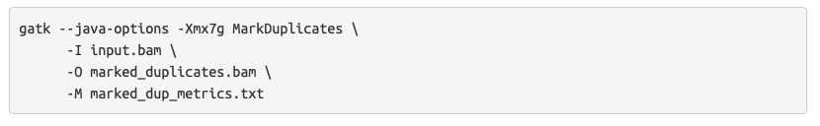

Slide 23
Base Quality Score Recalibration (BQSR)
Notes:
But before we dive in to alignment I will mention that this is where the recommendations of the Broad institute best practices start. A guide that they have maintained pretty-well for several years where they recommend tools and setting to use for a standard analysis. I recommend that someone setting up a bioinformatics workflow or wanting to compare what has been done with their data and what is currently considered best practice be intimately aware of these recommendations.
//A recent change has been made where they no longer recommend indel realignment, as it is performed on the fly at the variant calling stage. It is good to note that this resource exists, as it is definitely something you should be looking at when running a variant calling pipeline as it is needed in some cases.

Slide 24
Base Quality Score Recalibration (BQSR)
During base calling, the sequencer estimates a quality score for each base. This is the quality scores present in the fastq files.
Systematic (non-random) errors in the base quality score estimation can occur.
due to the physics or chemistry of the sequencing reaction
manufacturing flaws in the equipment
etc
Can cause bias in variant calling
Base Qualtiy Score Recalibration helps to calibrate the scores so that they correspond to the real per-base sequencing error rate (phred scores)
Notes:
Base Quality Score Recalibration basically detects systematic errors made by the sequencer when it estimates the quality score of each base call, which is basically how confident the machine was that the called base is correct.
Some of these errors are due to the physics or the chemistry of how the sequencing reaction works, and some can be due to manufacturing flaws in the equipment.
The tool checks the covariation between Reported quality score, the position within the read and the preceding and current nucleotide observed by the sequencing machine to find non-random discrepancies that lead to the score being adjusted.
These systematic technical errors, leading to over- or under-estimated base quality scores in the data.

Slide 25
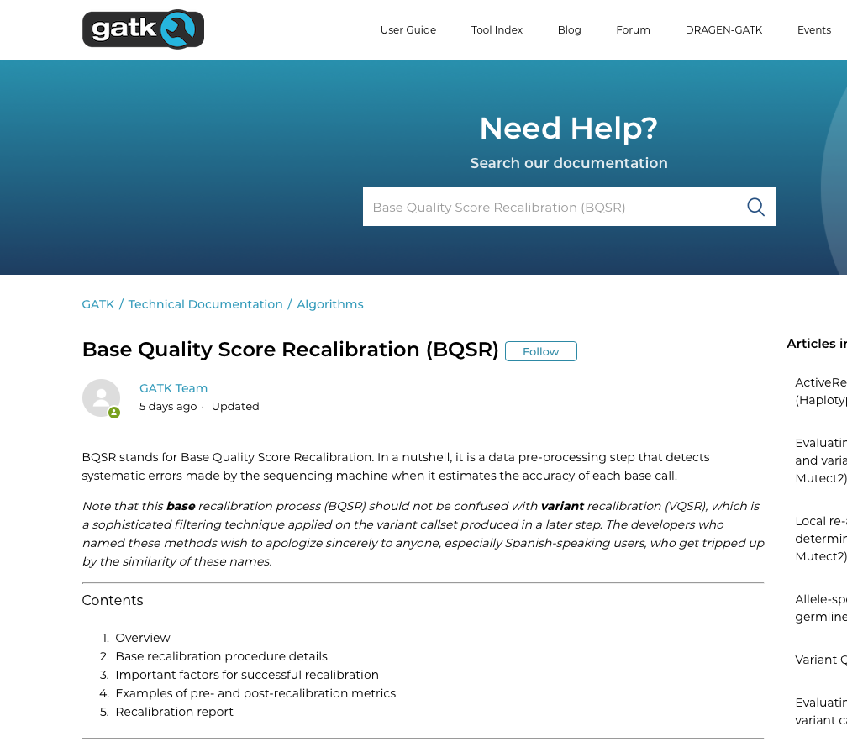

Slide 26
Filter variants
https://software.broadinstitute.org/gatk/best-practices/
Germline short variant discovery (SNPs + Indels)
Notes:
But before we dive in to alignment I will mention that this is where the recommendations of the Broad institute best practices start. A guide that they have maintained pretty-well for several years where they recommend tools and setting to use for a standard analysis. I recommend that someone setting up a bioinformatics workflow or wanting to compare what has been done with their data and what is currently considered best practice be intimately aware of these recommendations.
//A recent change has been made where they no longer recommend indel realignment, as it is performed on the fly at the variant calling stage. It is good to note that this resource exists, as it is definitely something you should be looking at when running a variant calling pipeline as it is needed in some cases.

Slide 27
Filtering
Remove low quality variants
Variant quality score recalibration (VQSR):
For large data sets ( >1 WGS or >30WES samples)
GATK has a machine learning algorithm that can be trained to recognise ”likely false” variants
We do recommend to use VQSR when possible!
Hard filters:
For smaller data sets
Hard filters on information in the VCF file
For example: Flag variants with ”QD < 2” and ”MQ< 40.0”
GATK recommendations on hard filters: https://gatkforums.broadinstitute.org/gatk/discussion/2806/howto-apply-hard-filters-to-a-call-set
Notes:
A typical scenario requiring manual filtration is small cohort callsets, e.g. less than thirty exomes.

Slide 28
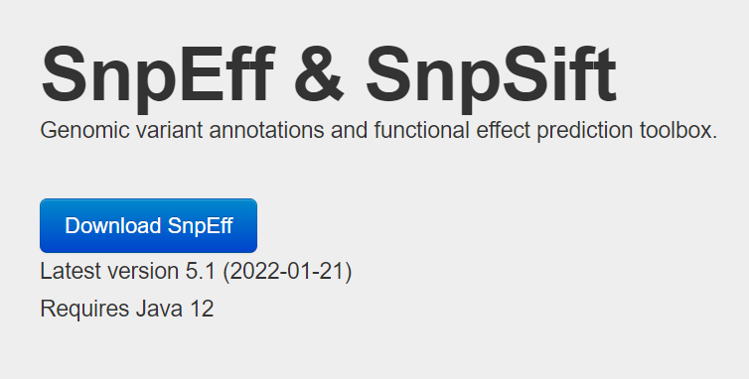
Annotation & effects prediction
Databases: clinvar, dbSNP, funcotator (FUNCtional annOTATOR), etc.

Slide 29
Demo & Results
Sequencing reports using FastQC.
Variant calling & annotation
Clinical report using dbSNP.
Notes:
Show ket qua trong thu muc results.

